Slide 1
Multi-modality Learning
Jian Tang
HEC Montreal
Mila-Quebec AI Institute
CIFAR AI Research Chair
Email: jian.tang@hec.ca

Slide 2
Outline
CLIP: Joint Text and Image Embedding
DALL-E-2: Generating Images from Text
LLaVA: Multi-modality Conversation

Slide 3
CLIP: Joint image and text representation learning (Radford et al. 2021)
Goal: learning SOTA image representations
Expensive to obtain a large amount of labeled images
Learning image representations from supervision contained in natural language
Training data: 400 million (image, text) pairs collected from Internet
Alec Radford, Jong Wook Kim, Chris Hallacy, Aditya Ramesh, Gabriel Goh, Sandhini Agarwal, Girish Sastry, Amanda Askell, Pamela Mishkin, Jack Clark, Gretchen Krueger, Ilya Sutskever. Learning Transferable Visual Models From Natural Language Supervision. arXiv:2103.00020:2103.00020

Slide 4
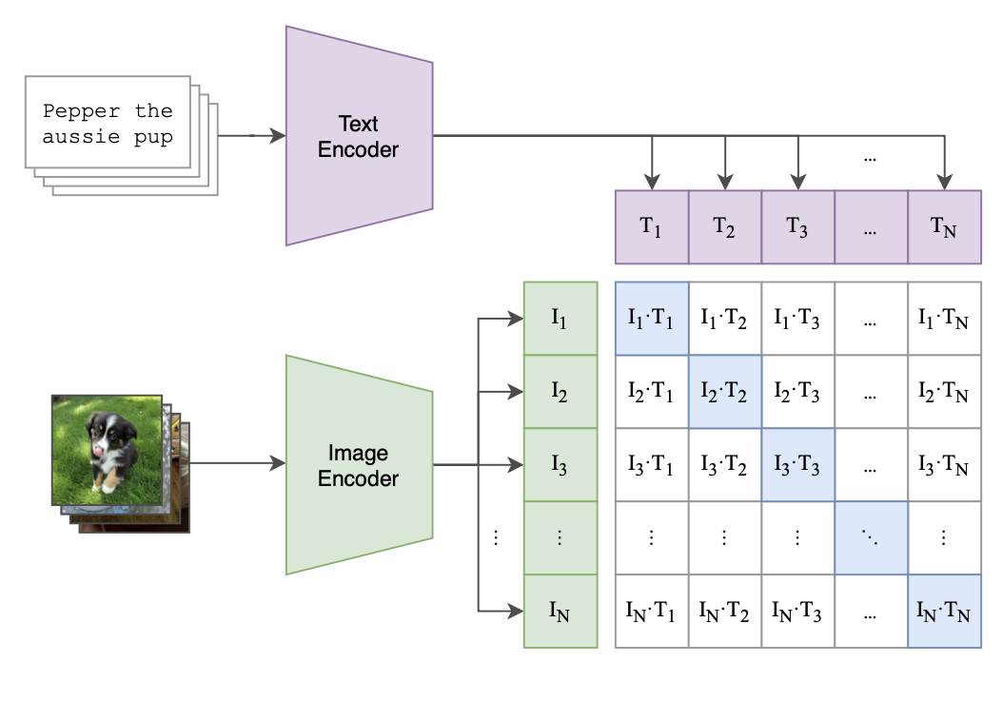
CLIP (Radford et al. 2021)
Contrastive Pre-training
A text encoder based on a Transformer language mod
An image encoder
Jointly train an image encoder and a text encoder to predict the correct pairings of a batch of (image, text) training examples

Slide 5
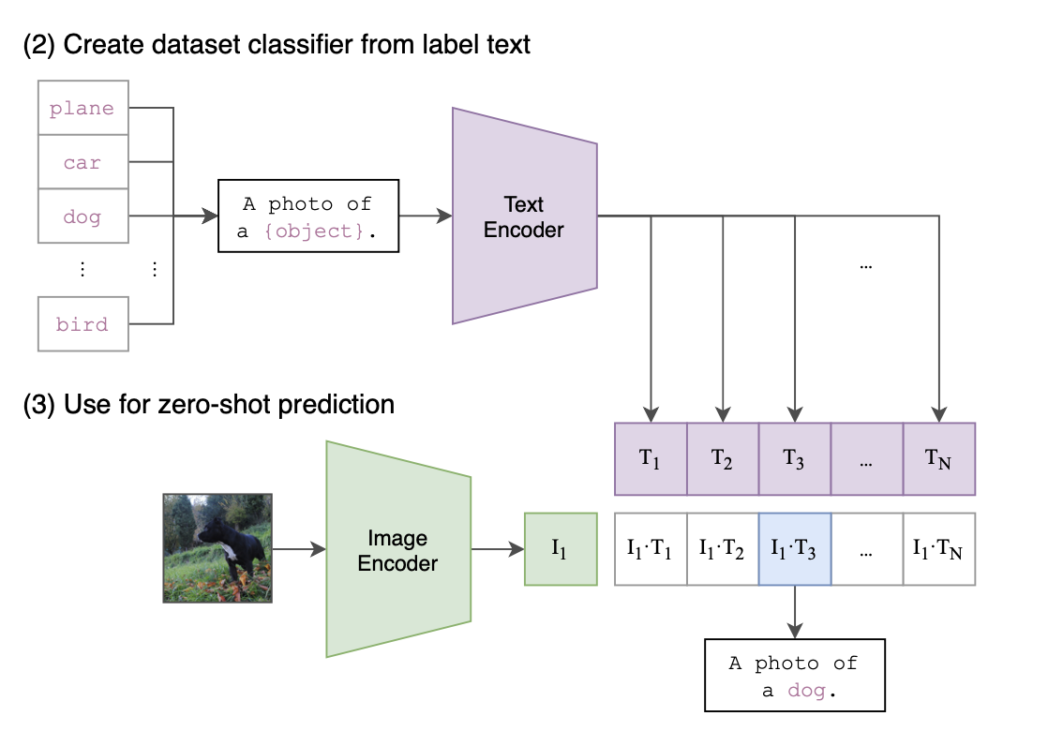
Zero-shot Image Classification
Use the names of all the classes in the dataset as the set of potential text pairings
Predict the most probable (image, text) pair according to CLIP
Compute the class embedding with the text encoder
Compute the image embedding with the image encoder
$$p\left(y_{i} | x\right)=\frac{exp⁡(cosine(vec\left(x\right), vec\left(y_{i}\right))}{\sum_{j=1}^{K}{\exp\left(cosine\left(vec\left(x\right),vec\left(y_{j}\right)\right)\right)}}$$

Slide 6
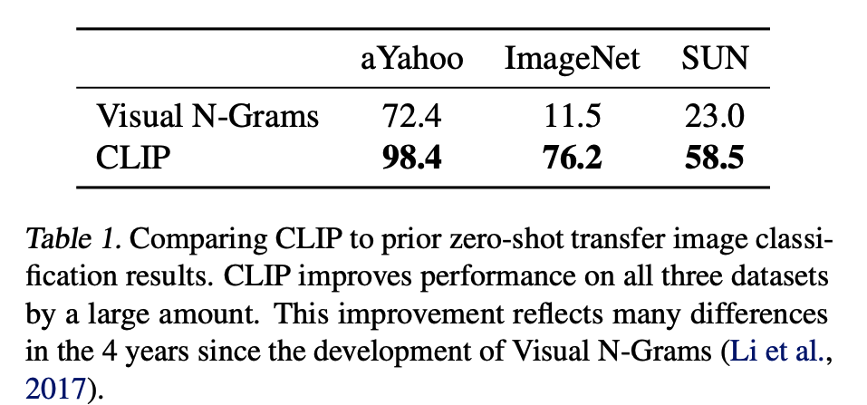
Zero-shot Performance
Significant performance improvement compared to previous methods

Slide 7
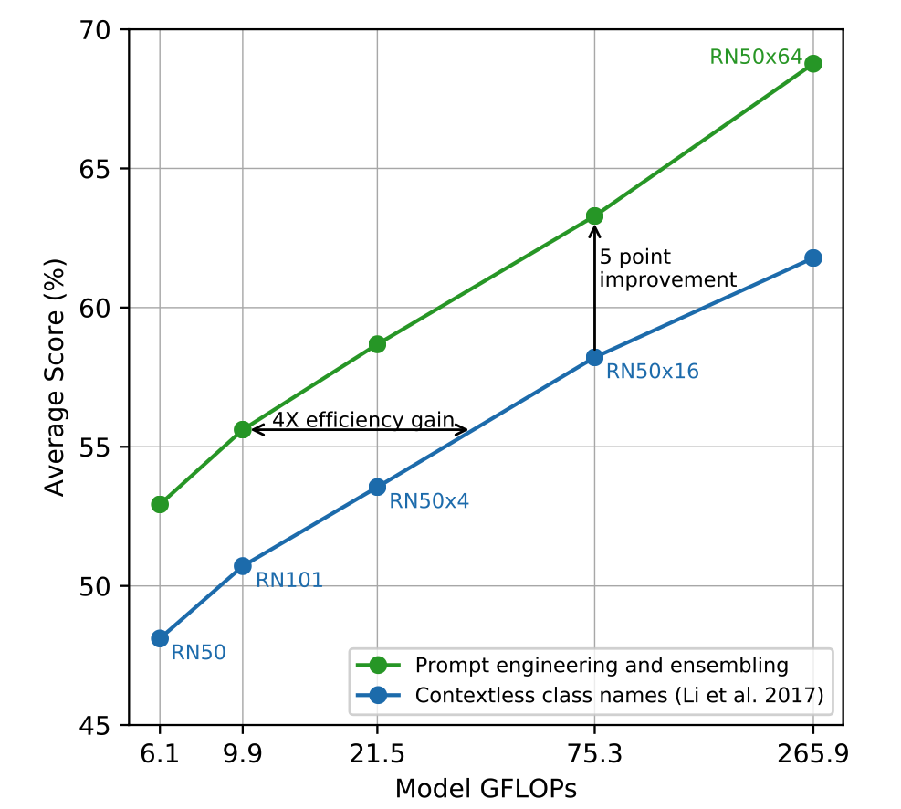
Prompt Engineering and Ensembling
Class encoder with different prompts:
Only with the class names
With the prompt “A photo of a {label}.”
Ensemble multiple classifiers with different context prompts, e.g.,
‘A photo of a big {label}”
“A photo of a small {label}”
The ensemble is constructed in the embedding space

Slide 8
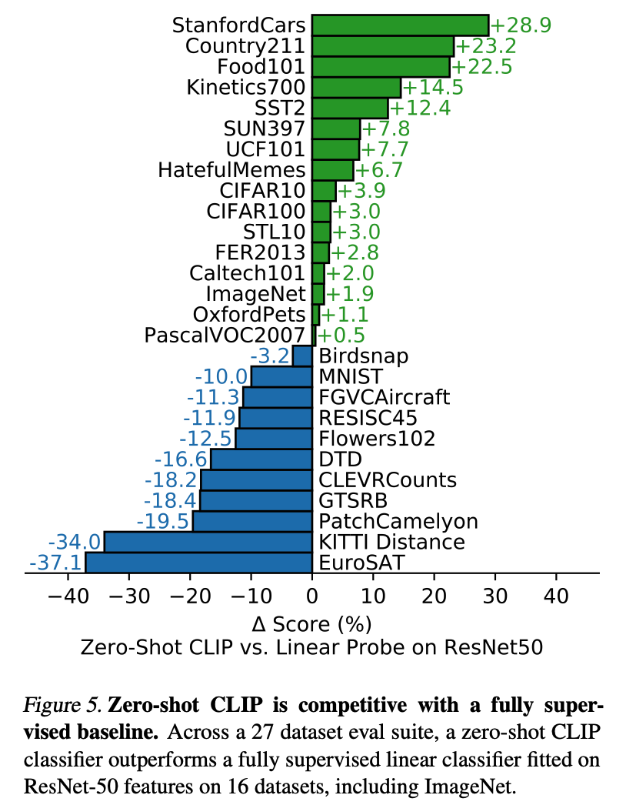
Zero-shot CLIP is competitive with a fully supervised baseline

Slide 9
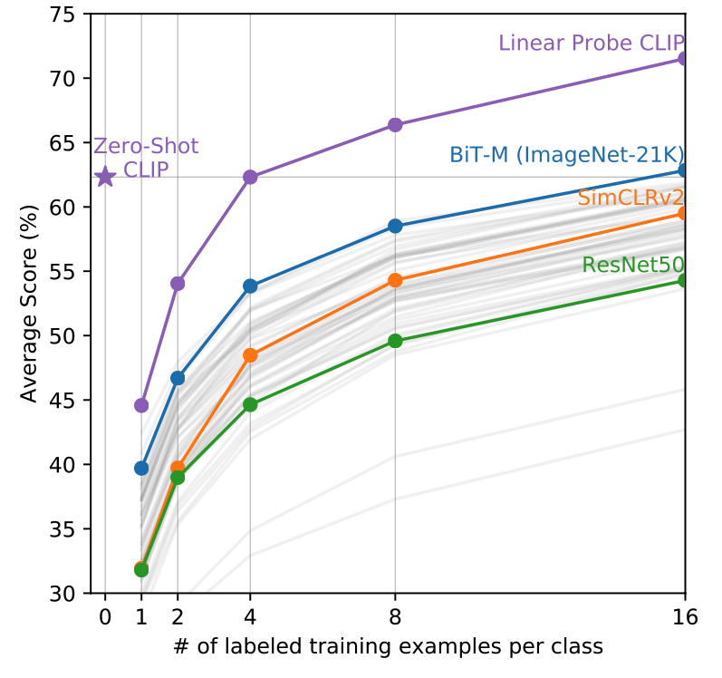
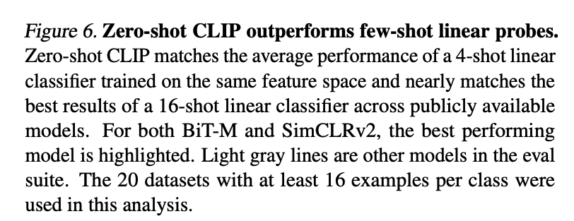
Zero-shot CLIP outperforms few-shot linear probes

Slide 10
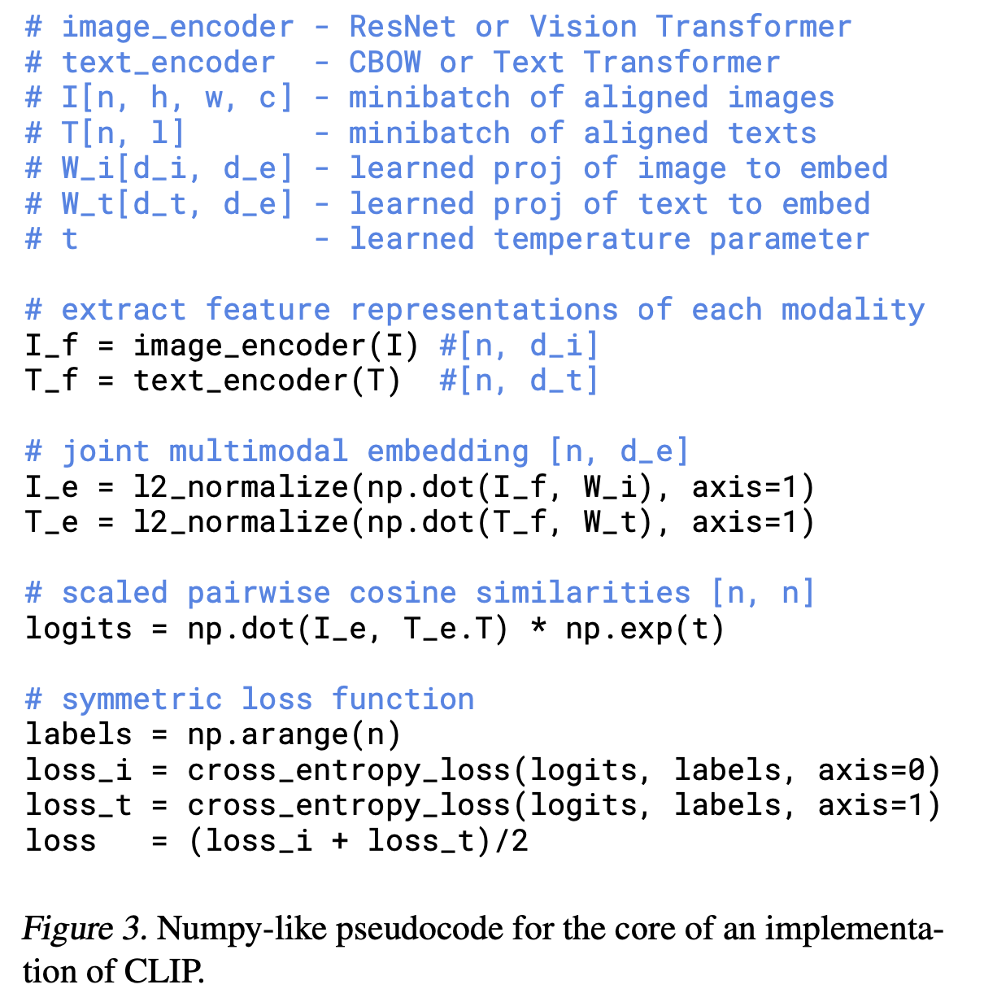
Implementation

Slide 11
Outline
CLIP: Joint Text and Image Embedding
DALL-E-2: Generating Images from Text
LLaVA: Multi-modality Conversation

Slide 12
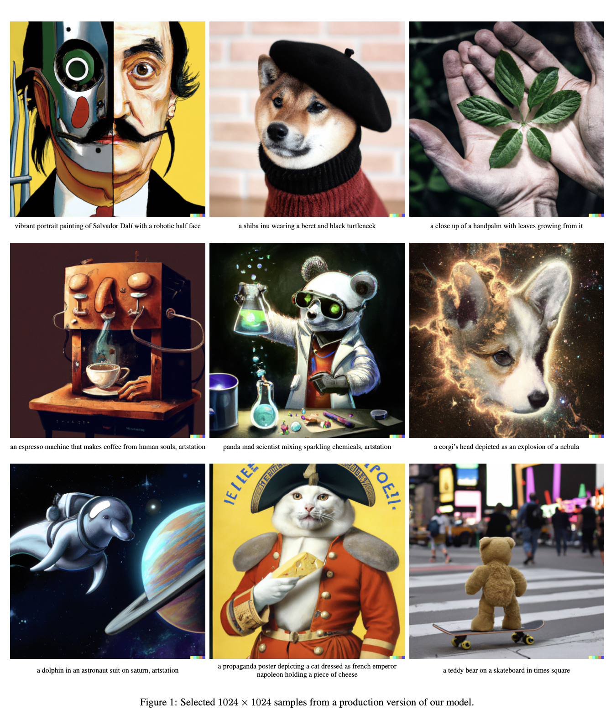
DALLE.2: generating images from text
Aditya Ramesh, Prafulla Dhariwal, Alex Nichol, Casey Chu, Mark Chen. Hierarchical Text-Conditional Image Generation with CLIP Latents. arXiv:2204.06125.

Slide 13
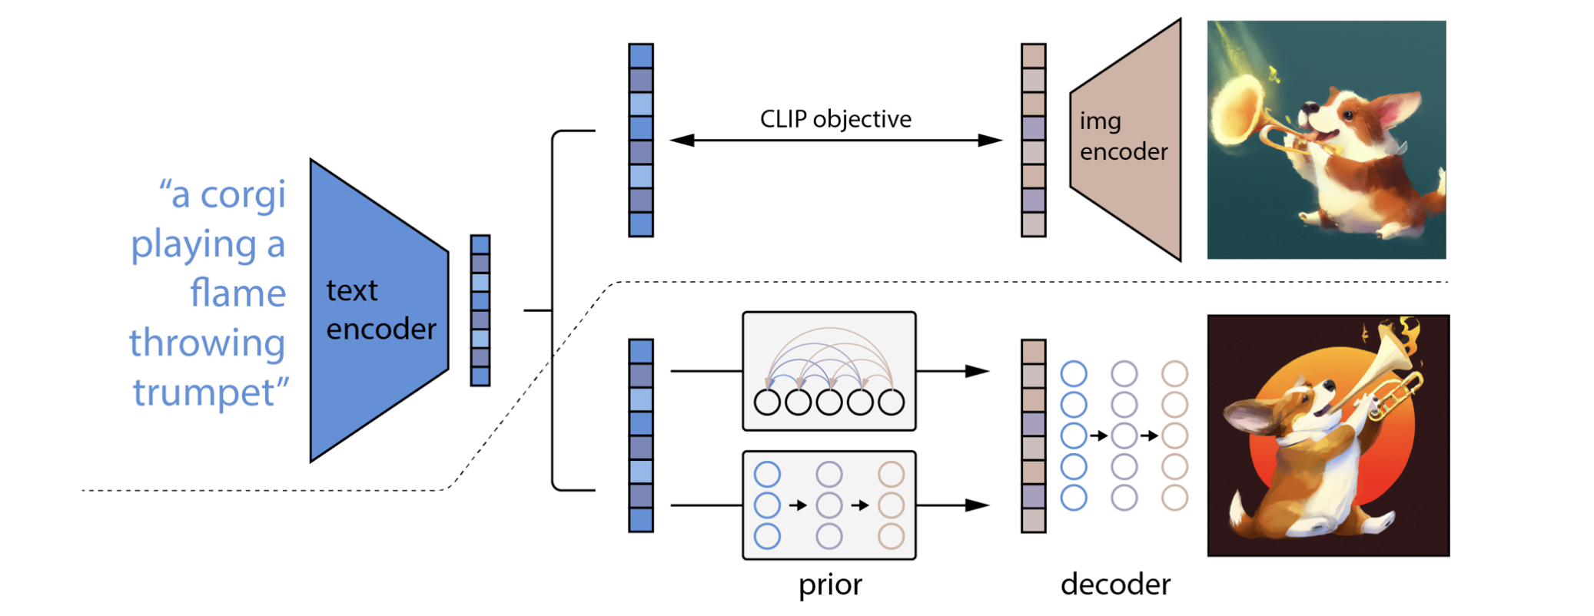
Model Architecture
Learning a joint representation space for text and images based on CLIP
A CLIP text embedding fed to an autoregressive or diffusion model to produce an image embedding
Generate the final image with a diffusion decoder conditioning on the image embedding

Slide 14
The probabilistic formulation
Given a pair of image $x$ and its corresponding caption $y$, $z_{i}$ and $z_{t}$ are the images and text embeddings respectively, we define the generative model as follows:
A prior $p\left(z_{i} | y\right):$produces CLIP image embeddings $z_{i}$ conditioned on captions $y$;
A decoder $p\left({x|z}_{i},y\right):$generate the final image $x$ conditioning on $z_{i}$

Slide 15
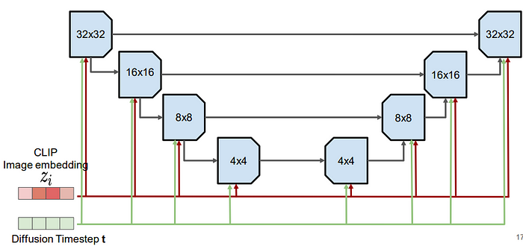
Decoder $p\left({x|z}_{i},y\right)$
A U-Net diffusion model for image generation conditioning on CLIP image embedding $z_{i}$

Slide 16
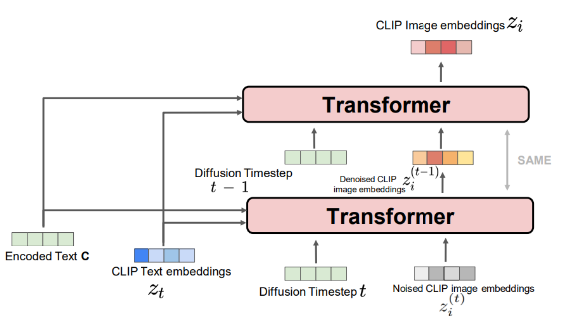
Prior $p\left(z_{i} | y\right)$
Diffusion Prior uses a diffusion model on CLIP image embedding. The input to this model is encoded text, CLIP text embedding, timestep, and noised CLIP image embedding. The continuous vector z is directly modelled using a Gaussian diffusion model conditioned on the caption y.
y

Slide 17
Outline
CLIP: Joint Text and Image Embedding
DALL-E-2: Generating Images from Text
LLaVA: Multi-modality Conversation

Slide 18
LLAVA: Large Language and Vision Assistant
Leverage GPT-4 to generate multimodal language-image instruction-following data
Instruction tuning on such generated data and building an end-to-end trained large multimodal model:
Connects a vision encoder and an LLM for general purpose visual and language understanding
Haotian Liu*, Chunyuan Li*, Qingyang Wu, Yong Jae Lee. Visual Instruction Tuning. NeurIPS 2023.

Slide 19
GPT-assisted Visual Instruction Data Generation
Leverage ChatGPT/GPT-4 for multimodal instruction-following data collection, based on the widely existing image-pair data.
For each $(X_{v},X_{c})$ image and caption pair, we use two types of information to prompt a text-only GPT
Captions $X_{c}$
Bounding boxes: localize the objects in the scene

Slide 20
Three Different Types of Instruction-Following Data
Conversation
A conversation between the assistant and a person asking questions about the photo
Detailed description
Include a rich and comprehensive description for an image
Complex reasoning
In-depth reasoning questions

Slide 22
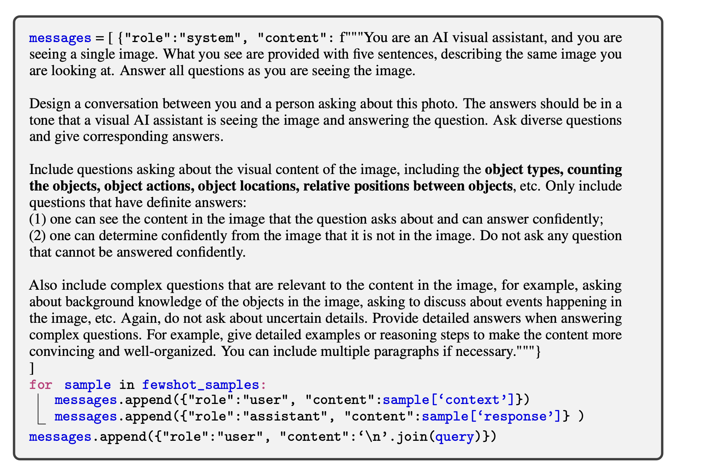
Prompts for Instruction-Following Data Generation

Slide 23
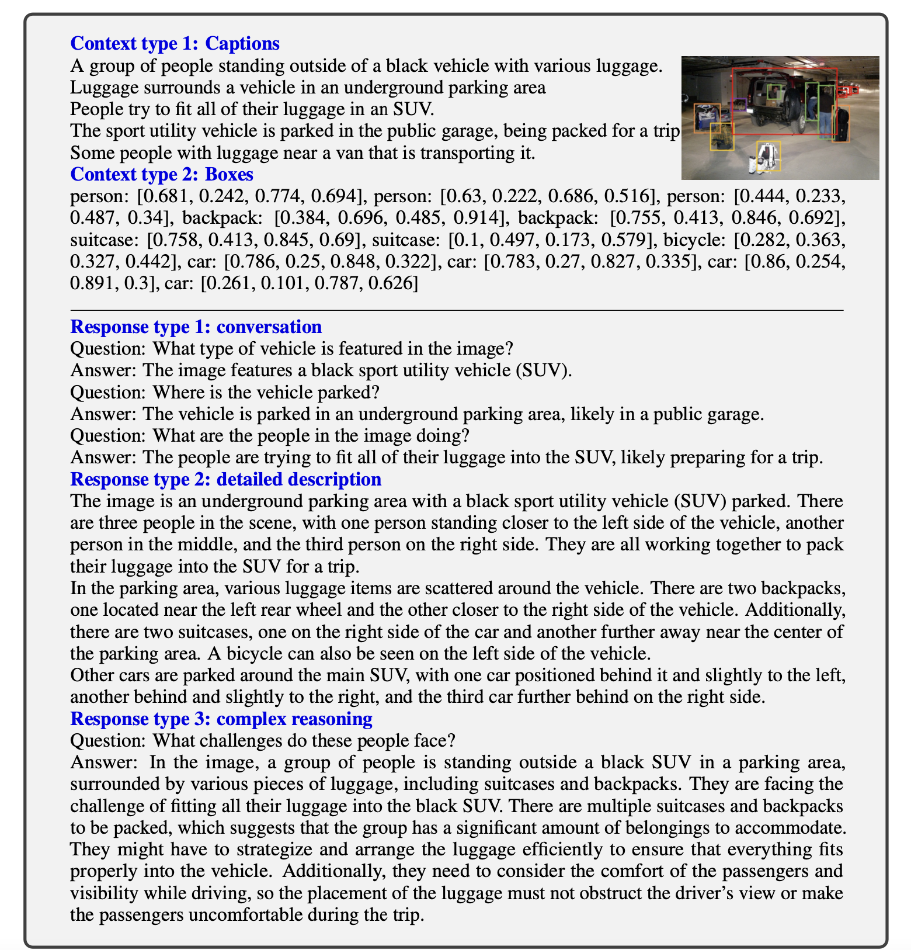
One example to illustrate the instruction-following data. The top block shows the contexts such as captions and boxes used to prompt GPT, and the bottom block shows the three types of responses. Note that the visual image is not used to prompt GPT, we only show it here as a reference.

Slide 24
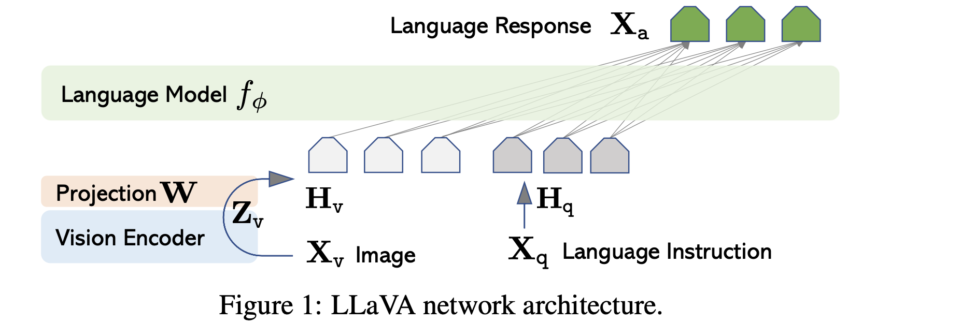
Visual Instruction Tuning Architecture
$f_{φ}:$ an LLM with parameters $φ$;
A pretrained CLIP visual encoder $Z_{v}=g\left(X_{v}\right)$

Slide 25
Training
For each image $X_{v}$, a multi-turn conversation data ${(X}_{q}^{1},$ $X_{a}^{1},…,X_{q}^{T}$, $X_{a}^{T}$), where T is the total number of turns. The instruction $X_{instruct}^{t}$ at the t-th turn is:

Slide 26
Training
For a sequence of length L, the probability of the target answers $X_{a}$ by:
Where $θ$ is the trainable parameters
$X_{instruct, <i}$ and $X_{a,<i}$ are the instruction and answer tokens in all turns before the current prediction token $x_{i}$
The model is trained to predict the assistant answers and where to stop, and thus only green sequence/tokens are used to compute the loss in the auto-regressive model.

Slide 27
Two-stage Instruction-tuning Procedures
Stage 1: Pre-training for Feature Alignment with single-turn conversations
Goal: align the CLIP imaging embedding space and LLM word embedding space
Data: expand an image-text pair to its instruction-following version is Human: $X_{q},X_{v}$ <STOP> Assistant : $X_{c}$ <STOP>
Training:
Keep both the visual encoder and LLM weights frozen
Maximize the likelihood w.r.t. the projection matrix $W$ only. The trainable parameters are $θ=W$

Slide 28
Two-stage Instruction-tuning Procedures
Stage 2: Fine-tuning End-to-End: always keep the visual encoder weights frozen, update the pre-trained weights of the projection layer $W$ and LLM in LLaVA $φ.$ The trainable parameters are:
$$θ=\{W,φ\}$$

Slide 29
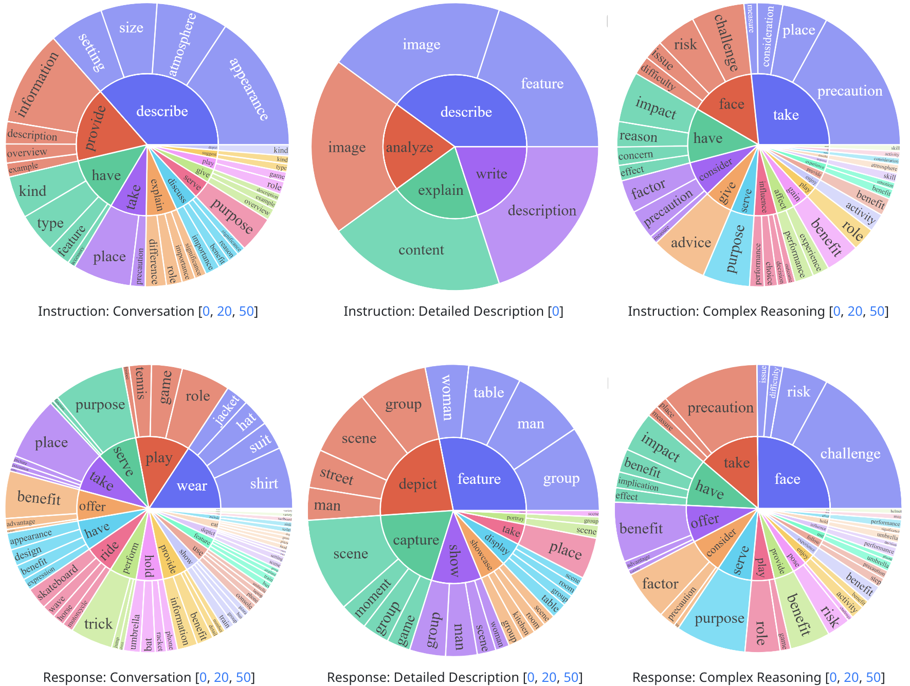
Application: Multimodal ChatBot
Fine-tuning on the 158K language-image instruction-following data.

Slide 30
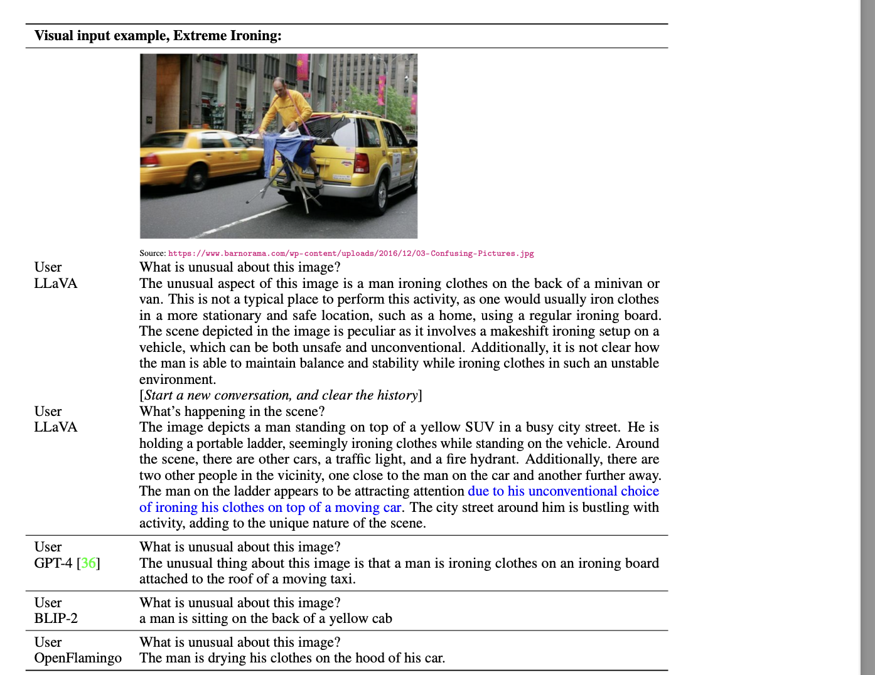

Slide 31
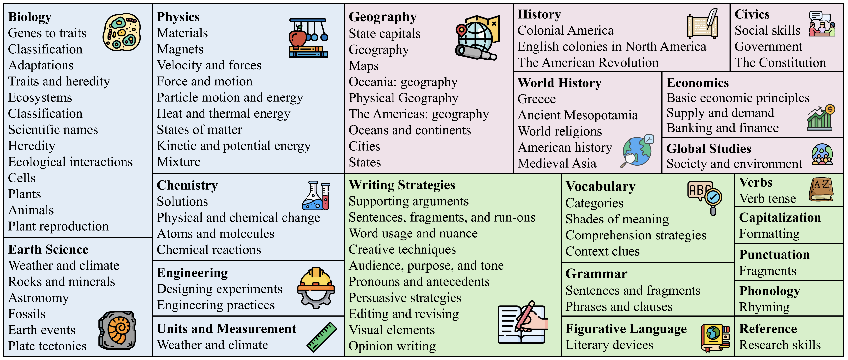
Application: Science Question Answering
ScienceQA dataset contains 21k multimodal multiple choice questions with rich domain diversity across 3 subjects, 26 topics, 127 categories, and 379 skills.
https://scienceqa.github.io/

Slide 33
Interacting with CLIP
https://colab.research.google.com/drive/1NRdzNsk58h9APO-Wo7ot8UCRX9kWxMHg?usp=sharing
https://medium.com/@elvenkim1/clip-by-openai-by-first-running-the-colab-7bbd8fc8ea07

Slide 34
Thanks!

