Slide 1
Deep Generative Models
Jian Tang
HEC Montreal
Mila-Quebec AI Institute
CIFAR AI Research Chair
Email: jian.tang@hec.ca

Slide 2
Outline
Introduction to Generative Models
Variational Auto-Encoders (VAEs)
Generative Adversarial Networks (GANs)
Denoising Diffusion Models (DDMs)

Slide 3
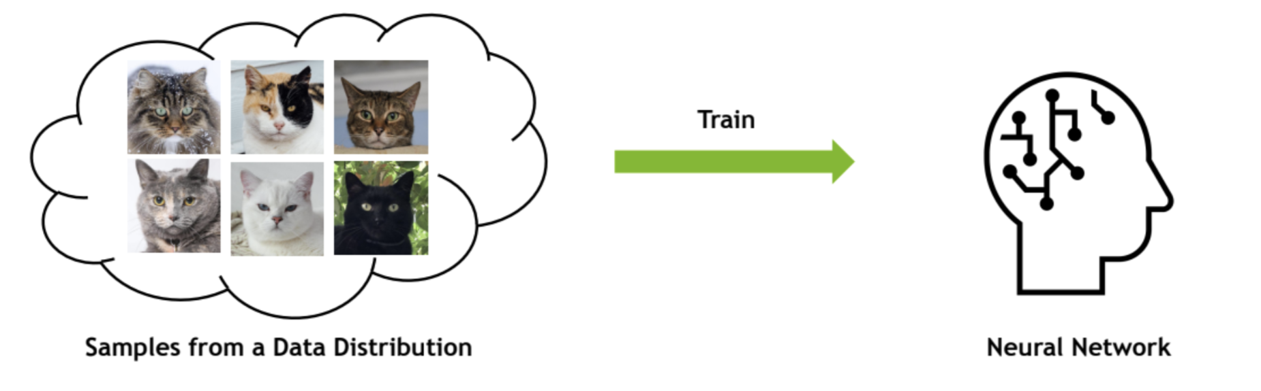
Deep Generative Models
Modeling the joint distribution $p\left(X\right)$, and drawing samples from it
Slide from https://github.com/cvpr2023-tutorial-diffusion-models

Slide 4
Application: (1) Image Generation
Slide from https://github.com/cvpr2023-tutorial-diffusion-models Image from StyleGan3

Slide 5
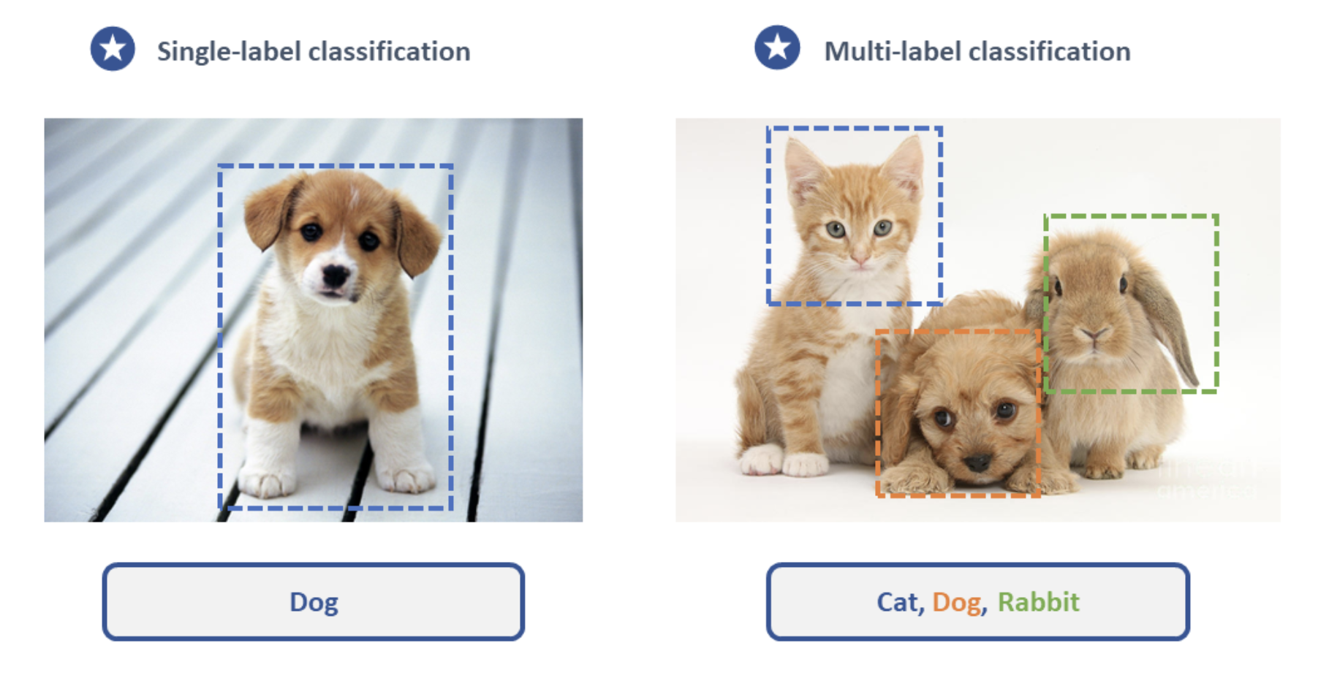
Application: (2) Representation Learning
Learning from limited labels
Image from https://research.aimultiple.com/image-classification/

Slide 6
Application: (3) Super-resolution
Image from https://heartbeat.comet.ml/super-resolution-580424fb7f7c

Slide 7
Application: (4) Colorization, Inpainting, Restoration
Image from Palette: Image-to-Image Diffusion Models https://arxiv.org/pdf/2111.05826

Slide 8
Application: (5) Outfilling
Image from Palette: Image-to-Image Diffusion Models https://arxiv.org/pdf/2111.05826

Slide 9
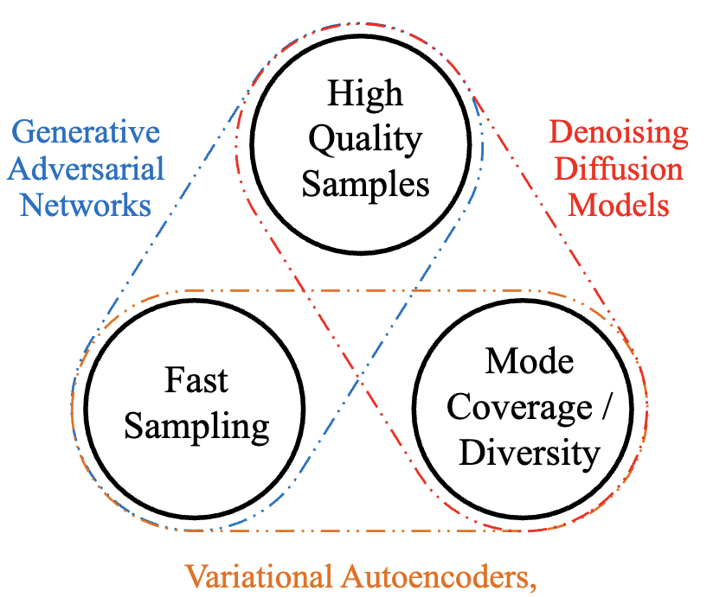
What Makes a Good Generative Model?
The generative learning trilemma
Image from Tackling the Generative Learning Trilemma with Denoising Diffusion GANs https://arxiv.org/pdf/2112.07804

Slide 10
Variational Auto-Encoders (VAEs)

Slide 11
Background: Auto-Encoders
Unsupervised approach for learning a low-dimensional feature representation from unlabeled training data
The dimension of z usually smaller than x (dimensionality reduction)
=> get features to capture meaningful factors in variations in data
Features
$$z$$
Encoder
Input data
$$x$$
Slide adapted from https://cs231n.stanford.edu/slides/2017/cs231n_2017_lecture13.pdf

Slide 12
Background: Auto-Encoders
How to learn this feature representation?
Train such that features can be used to reconstruct original data
L2 Loss Function: ${\left|\left|x −\hat{x}\right|\right|}^{2}$
No Needs to Use Labels
Reconstructed Input data
$$\hat{x}$$
Decoder
Features
$$z$$
Encoder
Input data
$$x$$

Slide 13
Background: Use Case of Auto-Encoders
Encoder can be used to initialize a supervised model
Loss Function
Predicted Labels
$$\hat{y}$$
$$\hat{y}$$
Fine-tune encoder jointly with classifier
Classifier
Features
$$z$$
Encoder
Input data
$$x$$

Slide 14
Variational Auto-Encoder (VAE)
Can we generate new images from an auto-encoder?
=> Variational auto-encoder (VAE)
Auto-Encoder
Variational Auto-Encoder (VAE)
Reconstructed Input data
$$\hat{x}$$
$$\hat{x}$$
Decoder
Decoder
Features
Sample from Latent Space
$$z$$
$$z\sim q\left(z\right|x, φ)$$
Encoder
Encoder
Input data
$$x$$
$$x$$

Slide 15
Variational Auto-Encoder (VAE)
Assume training data ${\left\{x^{\left(i\right)}\right\}}_{i=1}^{N}$ generated from underlying unobserved (latent) representation $z$
$$p\left(x\right)=p\left(z\right)p(x|z)$$
Sample from True Conditional
$$p_{θ^{∗}}(x|z^{\left(i\right)})$$
$$\hat{x}$$
Decoder
Sample from True Prior
$$p_{θ^{∗}}(z)$$
$$z$$

Slide 16
Variational Auto-Encoder (VAE)
How to train the model?
Learn model parameters $θ$ to maximize likelihood of training data
$p_{θ}\left(x\right)=∫p_{θ}\left(z\right)p_{θ}\left(x | z\right)dz$
Intractable to compute $p_{θ}\left(x | z\right)$for every $z$
Sample from True Conditional
$$p_{θ^{∗}}(x|z)$$
$$\hat{x}$$
Decoder
Sample from True Prior
$$p_{θ^{∗}}(z)$$
$$z$$

Slide 17
Variational Inference*
$$log p\left(x\right)≥∫q\left(z|x\right)\log{ \left(p\left(x | z\right) \frac{p\left(z\right)}{q\left(z|x\right)}\right)}dz$$
$$=∫q\left(z|x\right) log p\left(x | z\right) dz−∫q\left(z|x\right)\log{\frac{q\left(z|x\right)}{p(z)}} dz$$
Jensen Inequality
$$\log{∫p\left(x\right)g\left(x\right)dx}≥∫p\left(x\right)\log{g\left(x\right)dx}$$
Tractable!
Evidence Lower Bound (ELBO)
Simple Gaussian Prior
*$θ$ is ignored for simplicity
$$𝔼_{q\left(z|x\right)}[log p\left(x | z\right)]−KL[q(z|x)||p(z)]$$

Slide 18
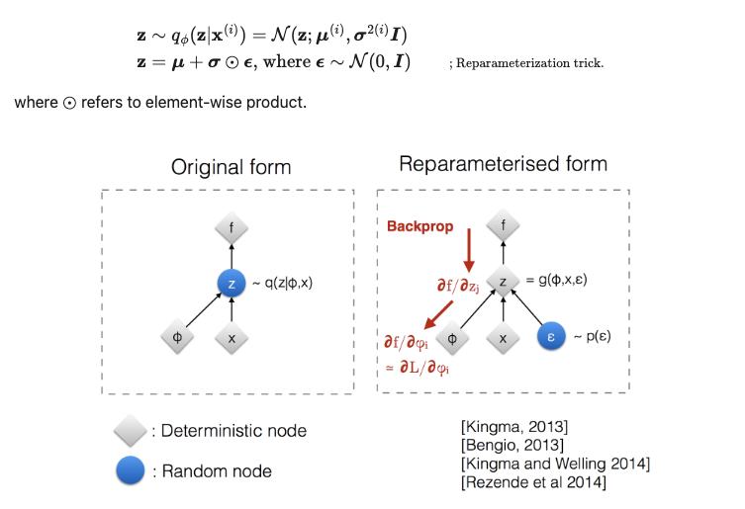
Parameterization of Posterior Distribution
Choose the proposed distribution $q\left(z|x\right)$ as a neural network $q_{φ}\left(z | x\right)$, modeling latents based on the observed input data
Figure from https://lilianweng.github.io/posts/2018-08-12-vae/

Slide 19
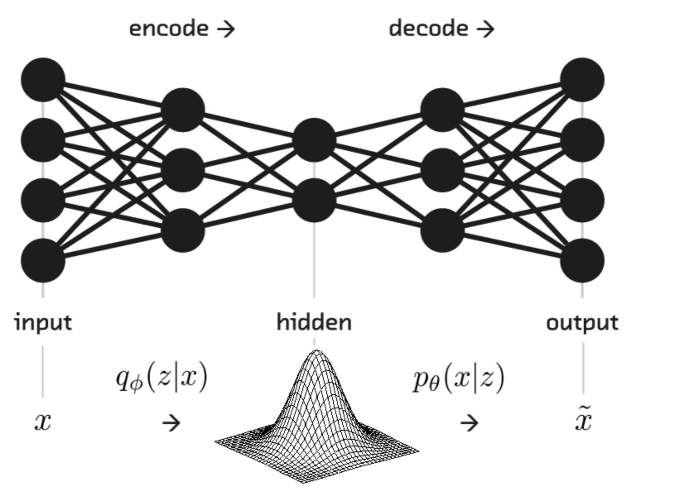
The Final ELBO Objective
$$𝔼_{q_{φ}\left(z|x\right)}[log p_{θ}\left(x | z\right)]−KL[q_{φ}(z|x)||p(z)]$$
ELBO
Reconstruction error
Distance between posterior and prior distributions

Slide 20
VAEs for Image Generation
Image from VAE: Auto-Encoding Variational Bayes https://arxiv.org/pdf/1312.6114

Slide 21
Open-source Code
https://colab.research.google.com/github/smartgeometry-ucl/dl4g/blob/master/variational_autoencoder.ipynb

Slide 22
Generative Adversarial Network (GAN)

Slide 23
Two Components
Generator
A generator used for data generation
Discriminator
Used to distinguish between real images and fake images generated from the generator

Slide 24
GAN Architecture
Generator: generate fake samples, tries to fool the Discriminator
Discriminator: tries to distinguish between real and fake samples
Slide from https://slazebni.cs.illinois.edu/spring17/lec11_gan.pdf

Slide 25
Training Discriminator
Slide from https://slazebni.cs.illinois.edu/spring17/lec11_gan.pdf

Slide 26
Training Generator
Slide from https://slazebni.cs.illinois.edu/spring17/lec11_gan.pdf

Slide 27
GAN’s Formulation
Slide from https://slazebni.cs.illinois.edu/spring17/lec11_gan.pdf

Slide 28
Latent Vectors Capture Interesting Patterns
Slide from Unsupervised Representation Learning with Deep Convolutional Generative Adversarial Networks https://arxiv.org/abs/1511.06434

Slide 29
Track Updates at the GAN Zoo
Slide from https://efrosgans.eecs.berkeley.edu/CVPR18_slides/Introduction_by_Goodfellow.pdf

Slide 30
Denoising Diffusion Model

Slide 31
The State-of-the-Art Generative Model
Image from Midjourney v4.

Slide 32
Why Diffusion?
VAE & GAN:
Convert latent noise vector to target distribution in one step
Diffusion:
Estimating and analyzing in small step sizes are more tractable and easier
Forward diffusion process gradually adds noise to input
Reverse denoising process learns to generate data by denoising
Image from https://cvpr2022-tutorial-diffusion-models.github.io/

Slide 33
Learning Process
The goal of a diffusion model is to learn the reverse denoising process to iteratively undo the forward process
In this way, the reverse process appears as if it’s generating new data from random noise
Slide from https://www.eecs.umich.edu/courses/eecs442-ahowens/fa23/slides/lec11-diffusion.pdf

Slide 34
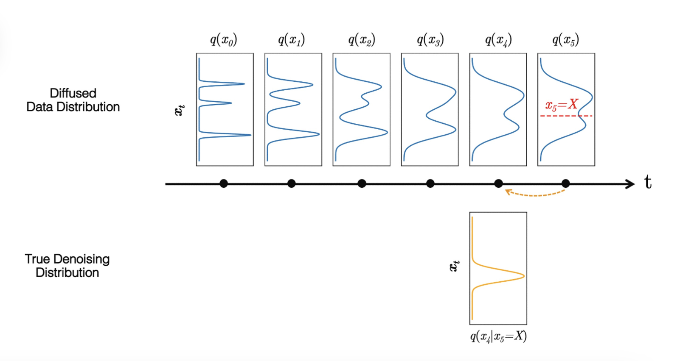
Distribution Changes Through Time
Slide from https://www.eecs.umich.edu/courses/eecs442-ahowens/fa23/slides/lec11-diffusion.pdf

Slide 35
Training
Diffusion models predict the noises from the input images, usually by using U-Net
Slide from https://www.eecs.umich.edu/courses/eecs442-ahowens/fa23/slides/lec11-diffusion.pdf

Slide 36
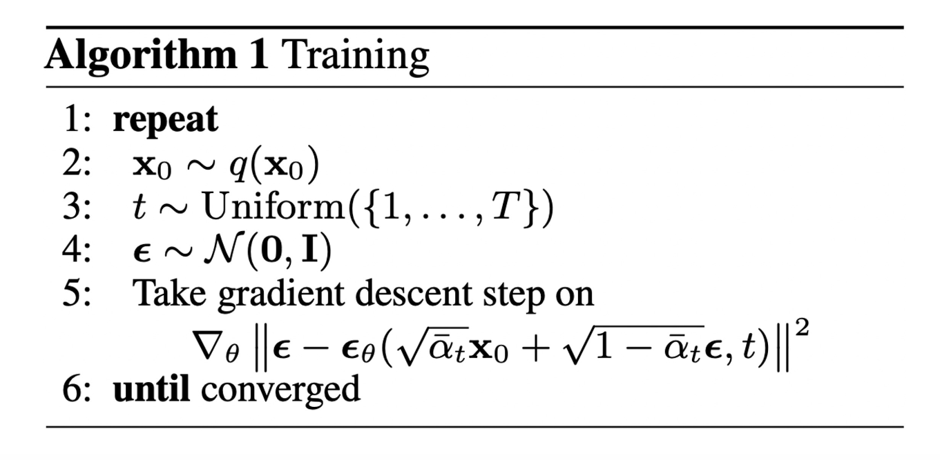
Training
Diffusion models predict the noises from the input images, usually by using U-Net
Random Noise
Model Predicted Noise

Slide 37
Model Details
Diffusion models often use the U-Net architecture with ResNet blocks and self-attention layers to predict the noise $ε_{θ}(x_{t}, t)$
Image from https://cvpr2022-tutorial-diffusion-models.github.io/

Slide 38
U-Net Based Diffusion Models
Image from https://cvpr2022-tutorial-diffusion-models.github.io/

Slide 39
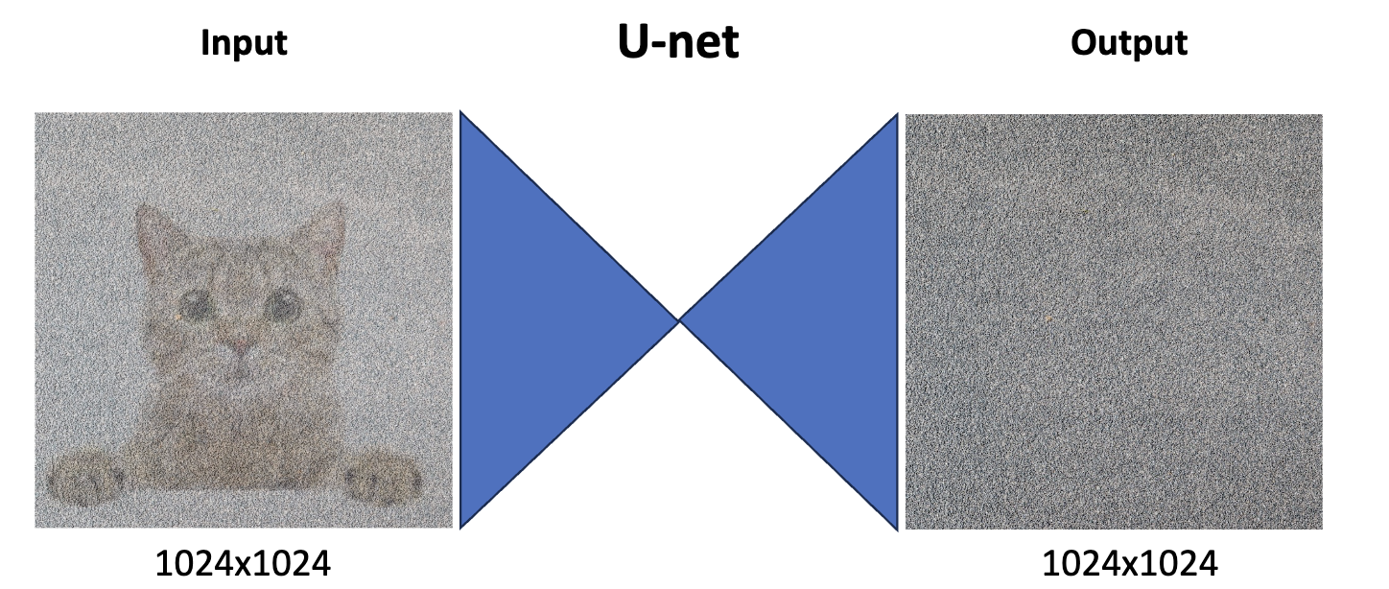
U-Net Problem
Problem: operating in the input space is very computationally expensive
Slide from https://www.eecs.umich.edu/courses/eecs442-ahowens/fa23/slides/lec11-diffusion.pdf

Slide 40
Option #1: Generate Low-Resolution + Upsample
Slide from https://www.eecs.umich.edu/courses/eecs442-ahowens/fa23/slides/lec11-diffusion.pdf

Slide 41
Option #2: Generate in Latent Space
Slide from https://www.eecs.umich.edu/courses/eecs442-ahowens/fa23/slides/lec11-diffusion.pdf

Slide 42
Impressive Results
Image from https://cvpr2022-tutorial-diffusion-models.github.io/

Slide 43
Conclusion
Variational Autoencoders (VAEs)
An encoder and decoder
Trained with variational inference
Generative Adversarial Networks (GANs)
A discriminator and generator
Training a generator to fool the discriminator
Denoising diffusion Decoders
Training a denoising network to recursively denoise a noising image starting from a noise

